Slide 1


Zomato Sales Performance Machavarapu Salman Raju 11th Feb 2024

Slide 2

Introduction:
Zomato is a popular Indian multinational restaurant aggregator and food delivery platform.
Founded in 2008 by
1.Deepinder Goyal
2.Pankaj Chaddah.
Zomato initially started as an online restaurant discovery platform, providing information about restaurants, menus, user reviews, and ratings.

Slide 3
Objectives:
This Project involves analysis of Zomato restaurant data using excel functions.
The given data set includes information about all the restaurants which are listed on the Zomato.
Restaurant ID & name
Country, City & Location along with Longitude and latitude
Currency of the country
Table booking (Yes/No)
Online Booking (yes/No)
Average cost for two people
Price range and rating

Slide 4
Data Overview:
Total Number of Restaurants (9542):
This indicates the sheer scale and variety of dining establishments available within the dataset.
The large number of restaurants could indicate a thriving food industry or a comprehensive database covering various dining options.
Total Number of Countries (15):
This reflects the international scope of the dataset, encompassing dining establishments from a diverse range of nations.
The inclusion of restaurants from 15 countries offers insights into cross-cultural dining experiences and preferences.
Total Number of Cuisines (145):
The diversity of cuisines indicates the potential for exploring various cultural and regional culinary experiences.
Average Rating of Restaurants (2.89):
The average rating serves as a benchmark for comparing the performance of individual restaurants against the dataset's overall standard.
9542
145
Total No. of
Restaurants
Total No. of
Cuisines
15
2.89
Total No. of
Countries
Avg. Rating of
Restaurants

Slide 5
Methodology:
Convert Data into a Table: Select the entire dataset, including headers if present, and convert it into an Excel Table. You can do this by going to the "Insert" tab, then selecting "Table" from the ribbon. Ensure the "My table has headers" option is checked if your data has column headers.
2
Identify Blank Cuisines: Assuming your dataset contains a column named "Cuisine" and there are blank entries in it, filter or sort the data to identify rows where the cuisine information is missing.
3
Delete Rows with Blank Cuisine Data: Once you've identified the rows with blank cuisine data, select those rows and delete them. You can do this by right-clicking on the selected rows and choosing "Delete" from the context menu.
4
Verify Data Consistency: After deleting the rows with blank cuisine data, review the dataset to ensure that all remaining entries are consistent and accurate. Check for any other anomalies or errors that may need to be addressed.
5
Save the Cleaned Dataset: Once you're satisfied with the cleaning process, save the cleaned dataset to preserve the changes you've made.
6
Examine the Dataset: Open the Excel file containing your dataset and thoroughly examine it to identify any inconsistencies or missing values. Look for any anomalies such as incorrect entries, inconsistent formatting, or empty cells.
1

Slide 6
Problem Statement:
Country wide no. of Restaurants
The provided dataset comprises 9542 restaurant entries, encompassing details such as unique IDs, names, countries of operation, cities, addresses, opening dates, cuisines offered, availability of online and table booking, price ranges, ratings, and average cost for two orders, facilitating comprehensive analysis of dining establishments.
The dataset provides information on the number of restaurants in various countries. It includes data for 15 countries, with counts ranging from 4 in Canada to 8652 in India.
The total number of restaurants across all countries is 9542. Notably, the United States of America has the highest number of restaurants at 425, followed by India with 8652 establishments.
The dataset encompasses a diverse range of countries, reflecting variations in dining culture and industry presence worldwide.
Country wide Number of Restaurants

Slide 7
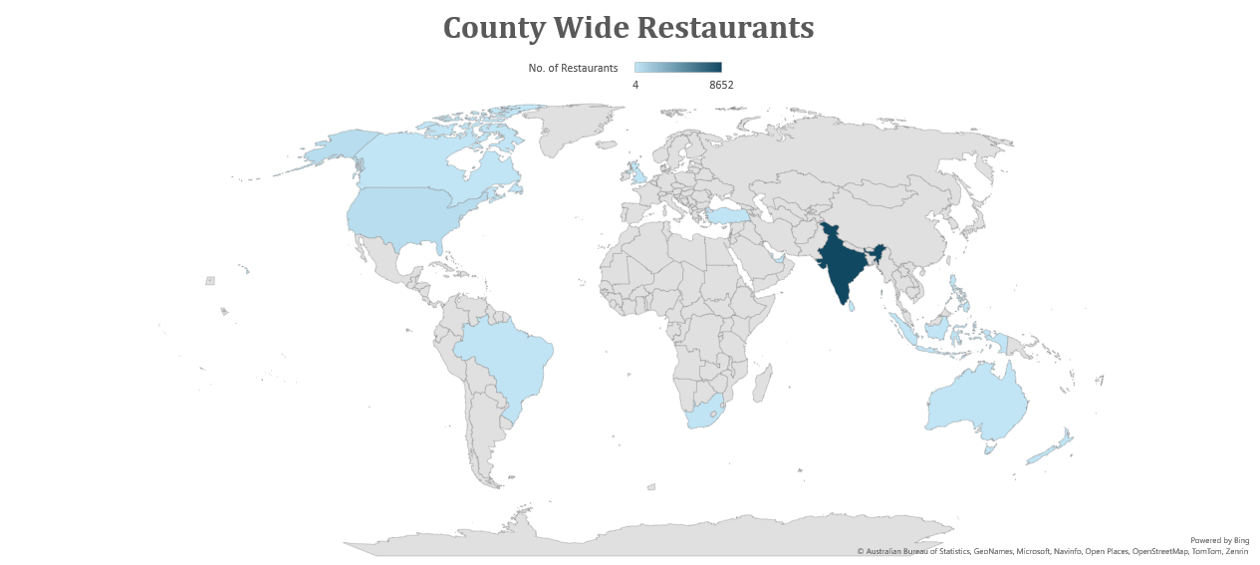
Country wide no. of Restaurants:

Slide 8
Year wise no. of Restaurants:
The dataset provides a yearly breakdown of the number of restaurants over the period from 2010 to 2018.
Across these nine years, the total number of restaurants is 9542. The data shows some fluctuations in the count, with a peak of 1102 restaurants in 2018 and a low of 1022 in 2012. Generally, the number of restaurants appears to remain relatively stable, with minor variations from year to year.
This information offers insights into the overall growth and trends in the restaurant industry over the specified time frame.
Year wide No. of Restaurants

Slide 9
Strategic Recommendations:
The dataset provides insights into restaurant popularity and quality across diverse countries, with significant variations in average ratings.
Countries like Turkey, New Zealand, and the UAE excel in both the number and quality of restaurants, boasting high ratings.
Singapore and Canada, while having fewer restaurants, exhibit lower average ratings, suggesting potential areas for culinary enhancement.

Slide 10
Global restaurant ratings showcase diverse culinary scenes, with cities like London and Dubai leading in average ratings.
Makati City in the Philippines stands out with the highest rating, reflecting exceptional culinary offerings and dining experiences.
Disparities in ratings are evident across different regions, highlighting the importance of local food cultures and preferences.
States and cities in the suggested countries suitable for opening restaurants:

Slide 11
Dataset encompasses city ratings worldwide, showcasing diverse travel experiences and preferences across continents and cultures.
Australian cities dominate the list, reflecting their popularity and appeal among travellers and tourists.
Rio de Janeiro's notably low rating suggests potential issues or areas for improvement in its tourism infrastructure and experiences.
The current quality regarding ratings for restaurants According to the countries suggested :

Slide 12
Rates of cuisines and ratings along with No. of Restaurants:
North Indian cuisine dominates with the highest number of restaurants, reflecting its popularity.
Fusion cuisines like North Indian, Mughlai, and Chinese also garner significant representation.
Despite varied offerings, average ratings across most categories remain relatively modest, suggesting room for improvement.

Slide 13
This data represents the average cost for two people in local currency (in Rupees) for dining out or meal expenses. It indicates significant variation across different countries, with Singapore and Qatar having the highest average costs, while Turkey has the lowest.
Average of avg Cost for two in Rs.
Country | Average of avg Cost for two in Rs.
Australia | ₹ 1,312
Brazil | ₹ 2,251
Canada | ₹ 2,225
India | ₹ 623
Indonesia | ₹ 1,481
New Zealand | ₹ 3,491
Philippines | ₹ 2,379
Qatar | ₹ 5,122
Singapore | ₹ 9,645
South Africa | ₹ 1,843
Sri Lanka | ₹ 655
Turkey | ₹ 220
United Arab Emirates | ₹ 3,776
United Kingdom | ₹ 5,032
United States of America | ₹ 2,196

Slide 14
Table Bookings and Online Bookings:
Table bookings
Country Name | Table booking |  | Grand Total
 | No | Yes
Australia | 24 | 0 | 24
Brazil | 60 | 0 | 60
Canada | 4 | 0 | 4
India | 7541 | 1111 | 8652
Indonesia | 21 | 0 | 21
New Zealand | 40 | 0 | 40
Philippines | 8 | 14 | 22
Qatar | 19 | 1 | 20
Singapore | 20 | 0 | 20
South Africa | 58 | 2 | 60
Sri Lanka | 20 | 0 | 20
Turkey | 34 | 0 | 34
United Arab Emirates | 42 | 18 | 60
United Kingdom | 68 | 12 | 80
United States of America | 425 | 0 | 425
Grand Total | 8384 | 1158 | 9542
Online delivery
Country Name | Online delivery |  | Grand Total
 | No | Yes
Australia | 24 | 0 | 24
Brazil | 60 | 0 | 60
Canada | 4 | 0 | 4
India | 6229 | 2423 | 8652
Indonesia | 21 | 0 | 21
New Zealand | 40 | 0 | 40
Philippines | 22 | 0 | 22
Qatar | 20 | 0 | 20
Singapore | 20 | 0 | 20
South Africa | 60 | 0 | 60
Sri Lanka | 20 | 0 | 20
Turkey | 34 | 0 | 34
United Arab Emirates | 32 | 28 | 60
United Kingdom | 80 | 0 | 80
United States of America | 425 | 0 | 425
Grand Total | 7091 | 2451 | 9542
There is a low prevalence of restaurants offering online ordering services, and table reservations are also relatively scarce. Below table data give clarity regarding Online delivery and table booking.
Table Booking is showing very few that is 1158 out of 9542 of restaurants.
Online delivery also showing very few that is 2451 out of 9542.
Details about Table booking, and Online delivery are shown in table.

Slide 15
Here is the analysis average number of voters for the restaurants in each country.
Average number of voters for the restaurants :
The average number of voters for the restaurants in each country
Country | Average of Votes
Australia | 111
Brazil | 20
Canada | 103
India | 137
Indonesia | 772
New Zealand | 243
Philippines | 407
Qatar | 164
Singapore | 32
South Africa | 315
Sri Lanka | 146
Turkey | 431
United Arab Emirates | 494
United Kingdom | 205
United States of America | 428

Slide 16
The dataset outlines the top 10 cuisine types along with their respective counts: North Indian ranks highest with 3960 occurrences, followed by Chinese with 2735 and Fast Food with 1986. Other prominent cuisines include Mughlai (995), Italian (764), Bakery (745), Continental (736), Cafe (703), Desserts (653), and South Indian (636). This information provides valuable insights into the most popular cuisine choices, aiding strategic decision-making in restaurant management and market targeting.
Average number of voters for the restaurants :

Slide 17
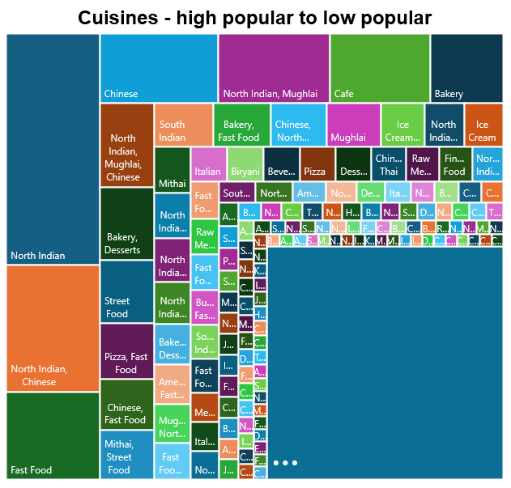
The dataset cuisine types along with their respective popularity: The culinary landscape offers a rich tapestry of flavors, from North Indian delicacies to Chinese delights, fast food indulgences, and beyond. Diverse palates converge in cafes, bakeries, and street corners, savoring global cuisines. From Mughlai feasts to continental treats, each dish narrates a story of cultural fusion and gastronomic exploration.
Cuisines in all Restaurants high to low popularity:

Slide 18
These are suggested countries where the team can open newer restaurants with lesser competition. Mentioned countries are having very few of restaurants.
Countries
United Kingdom
Brazil
South Africa
United Arab Emirates
New Zealand
Turkey
Australia
Philippines
Indonesia
Sri Lanka
Singapore
Qatar
Canada
suggested countries where the team can open newer restaurants :

Slide 19
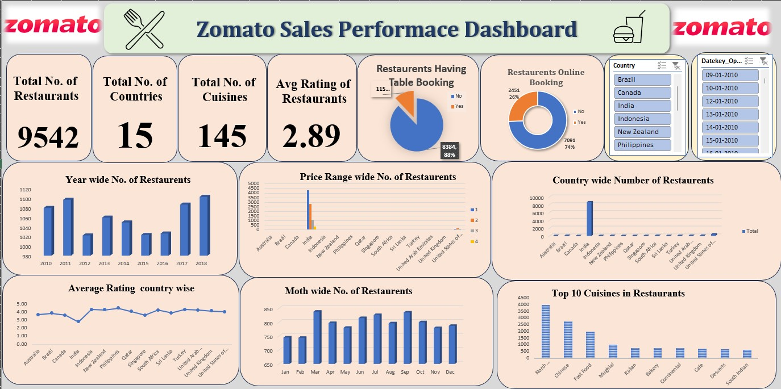

Slide 20
The dashboard provides a comprehensive overview of restaurant-related metrics, including:
The total number of restaurants
The variety of cuisines available
The average rating of restaurants
Cuisines are listed in descending order of popularity, allowing quick identification of the most prevalent cuisines.
Country and date slicers are included to facilitate customized reports based on specific countries and dates, enhancing data analysis and decision-making.
The dashboard also highlights:
The number of restaurants offering table booking
The number of restaurants providing online delivery services
Total restaurants categorized by price range and rating, providing insights into the distribution of restaurant offerings.
With these features, users can efficiently analyze restaurant data, understand trends, and make informed decisions tailored to their needs.

Slide 21

Contents of Dashboard:
﻿Pivot charts - For visualization & analysis of different trends and pattern.
Slicers - Make data visualization interactive
Comparison of different aspects (like price range and rating)
Impacts of different set of entities on different entities (e.g. impact of online delivery on rating)
Various analysis

Slide 22
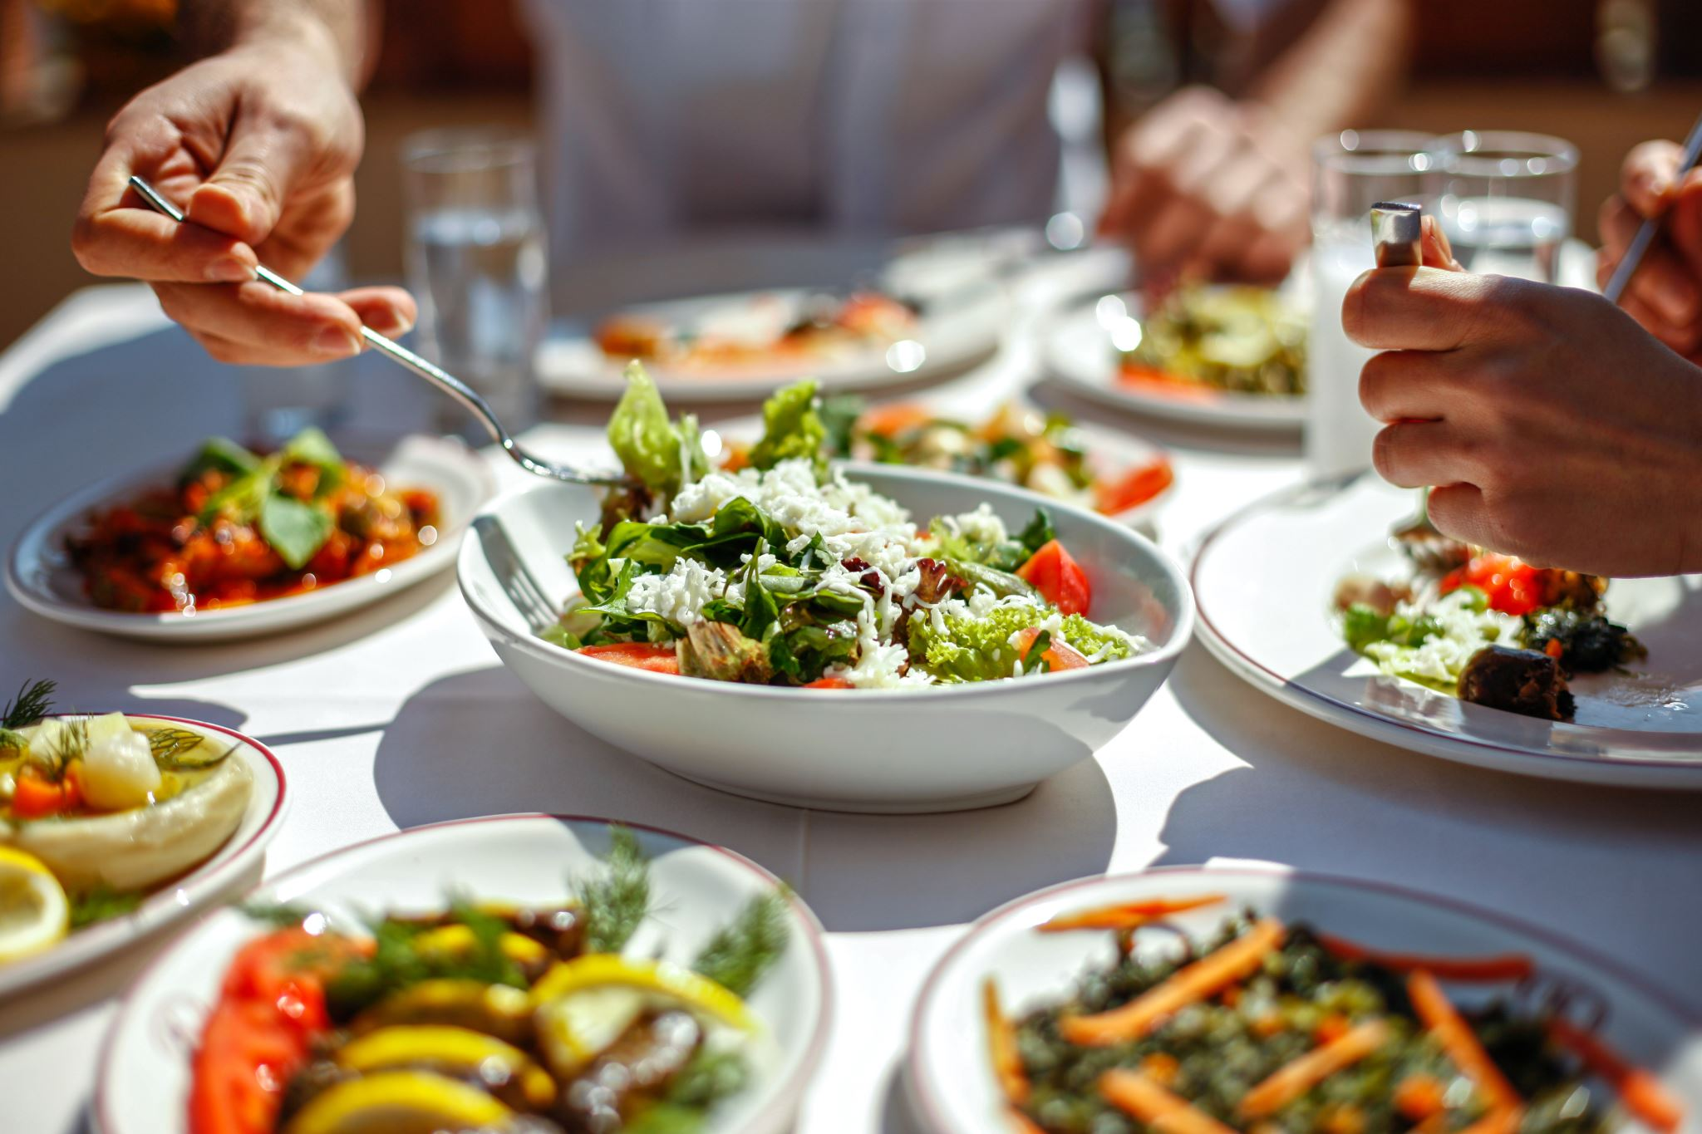
Conclusion:
Over nine years, from 2010 to 2018, Zomato underwent a remarkable transformation, evolving from a modest restaurant booking tech company into a prominent e-commerce giant.
As Zomato's global presence continues to grow, it strives to redefine the food delivery landscape and elevate dining experiences globally.
Through a commitment to innovation and superior customer service, Zomato aims to consolidate its position as a frontrunner in both food delivery and restaurant discovery.
This analysis suggests potential cities for the expansion of new restaurants or food services, contributing to the overall growth and success of the company.

Slide 23


